Slide 1


Welcome
For those in the Pro Se Family court membership or any of our other coaching programs or who have one of the consultation packages.
The Divorce Solutionist

Slide 2

Introduction
You have just started your journey to getting closer to the outcome you want in your Family Court case.
The Divorce Solutionist is dedicated to helping self-represented (or lawyer-represented) understand the process; find the answers needed while maintaining emotional/mental stability and clarity.
As the founder & creator of TDS, I take pride in providing you with the assistance and support you need to address every aspect of your family law case.
Tracey Bee, Family Court Strategist

Slide 3

What you can expect to:
Gain more control over your case & the overall outcome;
Get reassurance that you have done all you can to advocate for your & your children’s interests;
Become empowered, not allowing the OP or system to bully you anymore;
Learn more about how the court system is set up and its truths on how it destroys families;
Build up more confidence in how you show up in every aspect of your life;
Strengthen your communication skills to be a voice for your family;
Master your emotions and maintain mental stability/clarity;
Know your rights as a parent, advocate & litigant;
Seek vindication & have your story told to impact change.
Get the help, support & assistance you need with EVERY issue that affects your case.

Slide 4

Getting Started
Review the Agreement, sign & return.
Read the Rules & Rights/Responsibilities.
Know the features that are included in your specific package/program.
Log into your account on Simply Coach.
Be sure that you provided all information & documents requested.
Be sure to look out for emails from us.
Be active & interactive.
You need to be sure to follow each of these steps in order to ensure you get the most benefits of the program or package you signed up for.

Slide 5
Once You are Setup:
After you completed each step in the Setup you’re ready to get the help you need.
Familiarize yourself with your court’s website. Each state has resources on its .gov website.
Create an account on your court’s portal if allowed.
Establish your support system-coach, mental health, religious support, community support, support groups family & friends.
Work on your personal circumstances- work, finances, housing, medical/mental, insurance, etc.
Familiarize yourself with resources in your community &/or online.
Develop a system to gather, collect, organize, and sort all of your evidence.
Set up apps/software that will help you with calendaring, communicating, and documenting all events. (Listed separately.)

Slide 6
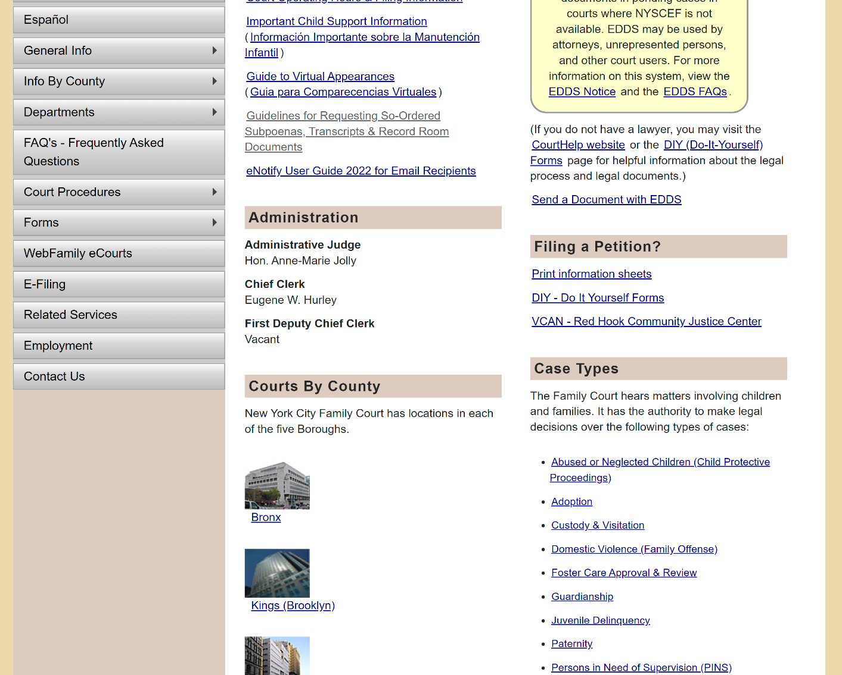
Court’s Website EXAMPLE:
New York State Court
https://ww2.nycourts.gov/COURTS/nyc/family/index.shtml
You can find forms, instructions, court information, and more.
You can create an account on the website, where you can check the calendar for your case, upload evidence, and e-file petitions/motions.

Slide 7
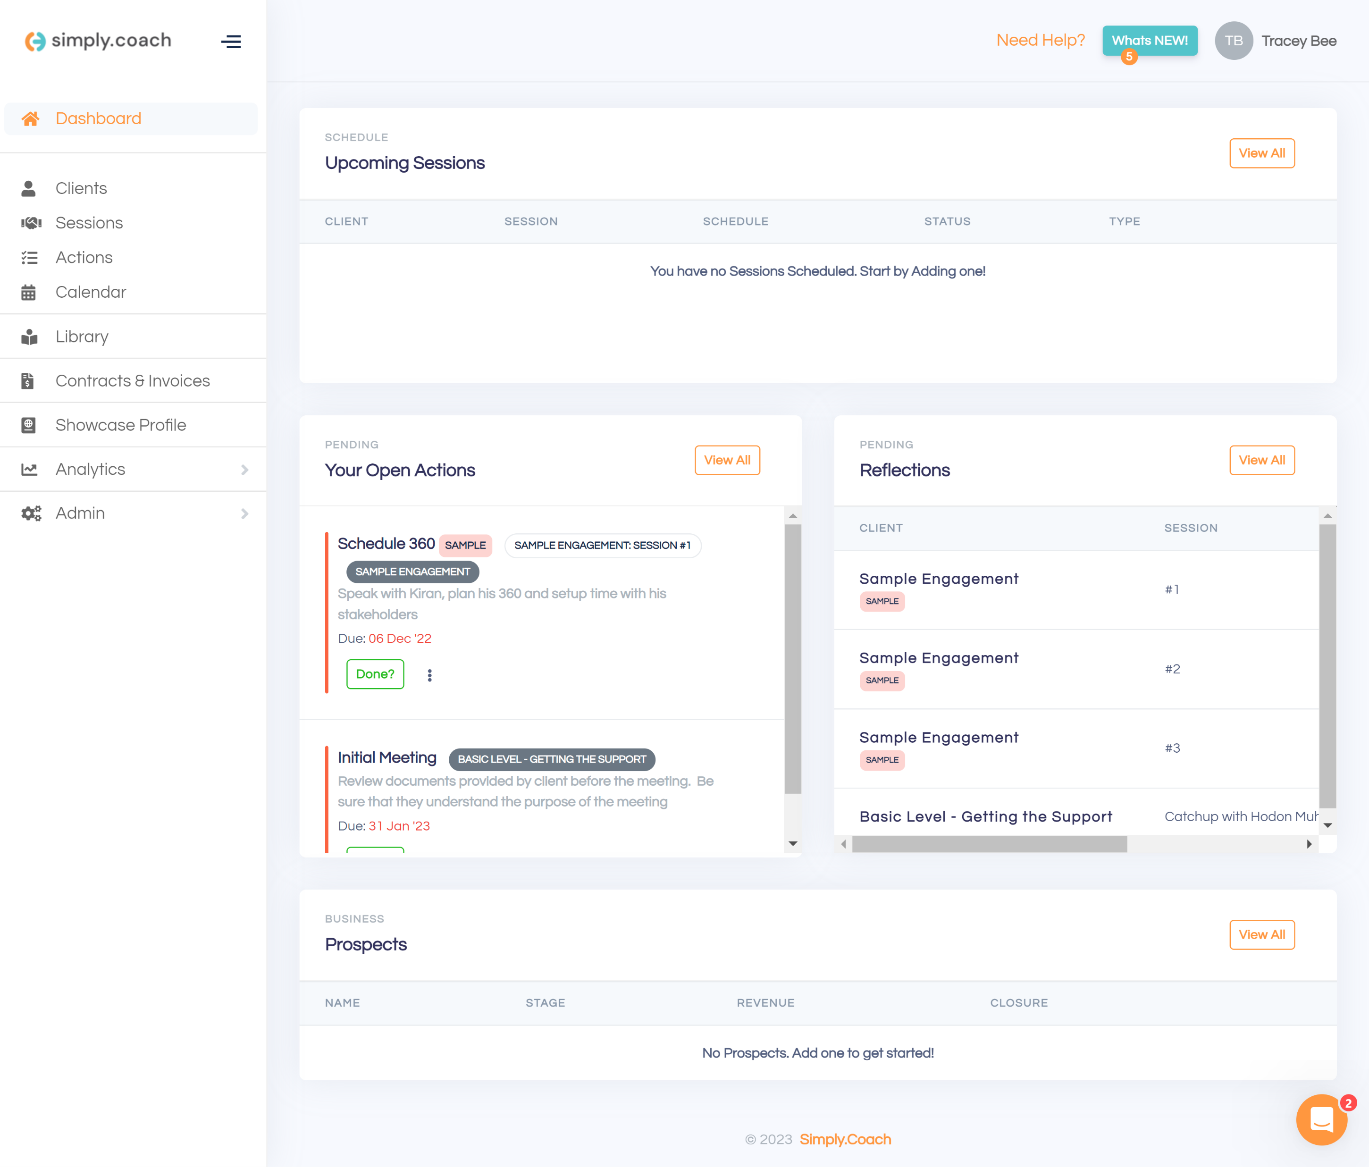
Coach/Client platform - Simply Coach This portal platform allows you to: 1. engage with your coach/consultant, 2. upload documents, audio, video, etc.; 3. maintain meetings & important dates; 4. access workshops, guides, forms, worksheets, etc.; 5. store important relevant notes and so much more. NOTE: (You will receive the link via email.)

Slide 8
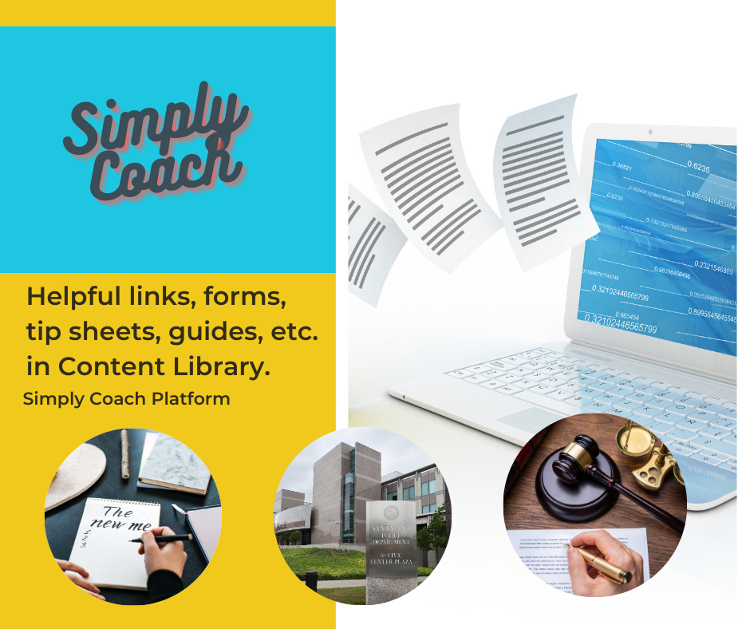
RESOURCES:
Self Improvement - parenting education & awareness, anger management programs, substance abuse services, job training, education, etc.
Community Help - Social service agencies, police departments & reporting agencies.
Resolution options - Mediation, parenting coordinators, coaches.
Legal - Free legal advice, pro bono organizations & legal plans, memberships, etc.
Apps & Software – coparenting, communication, documenting, calendar, financial tracking, evidence gathering, tracking, background search & legal research.
CHECK THE CONTENT LIBRARY IN SIMPLY COACH.

Slide 9

CONTENT LIBRARY- Videos & PDFs:
Video Titles–
Strategy in Family Court
Best Interests of the Child-Custody
Modification
Contempt
Financial Aspects of Divorce & Custody
Relocation
Gathering & Organizing Evidence
Trial Preparation
Mediation Preparation & Settlement Negotiations
Court Process & Procedure

Slide 10
CONTENT LIBRARY-
PDF Titles–
GUIDES:
Writing Petitions or Motions
Choosing the Right Attorney
Organizing Evidence
WORKBOOKS:
Evidence
Strategy
Mediation Prep
WORKSHEETS:
Evidence
Witness Prep
Opening & Closing Statements
Legal Research
Budget & Finances

Slide 11

Important Info & Tips:
*Contact info – divorcecoachesq@gmail.com
*Join the Facebook Group – ProSe Pro Per Divorce & Custody.
*Sign up to become an Affiliate.
*Give feedback, make referrals &
Suggest recommendations.
www.TheDivorceSolutionist.com

